Slide 1
Open House
Explore CPP
&
BroncoBound
Friday, January 24th, 2025

Slide 2
Open House
Fall: Explore CPP
Spring: BroncoBound
Audience: prospective students and families
Aim to be the first weekend in November
Estimated attendance of 4k
Audience: admitted students and families
Aim to be the second weekend in April
Estimated attendance of 10k

Slide 3
What to Expect at Open House?
A campus-wide signature event designed exclusively for admitted (Spring) and prospective students (Fall).
An opportunity for Cal Poly Pomona to showcase its vibrant campus community and diverse academic programs.
Engaging programming and interactive experiences aimed at helping students make the important decision to commit to CPP.
Fosters a sense of belonging and connection among prospective students before they officially begin their Bronco journey.

Slide 4
Key Features
Visit your academic college and explore majors.
Attend presentations and workshops
Participate in the Resource Fair
Connect with current students, faculty, and staff to get an inside look at the Bronco Experience
Participate in fun, interactive activities that highlight the CPP spirit!
Commit to Cal Poly Pomona by submitting your intent to enroll

Slide 5
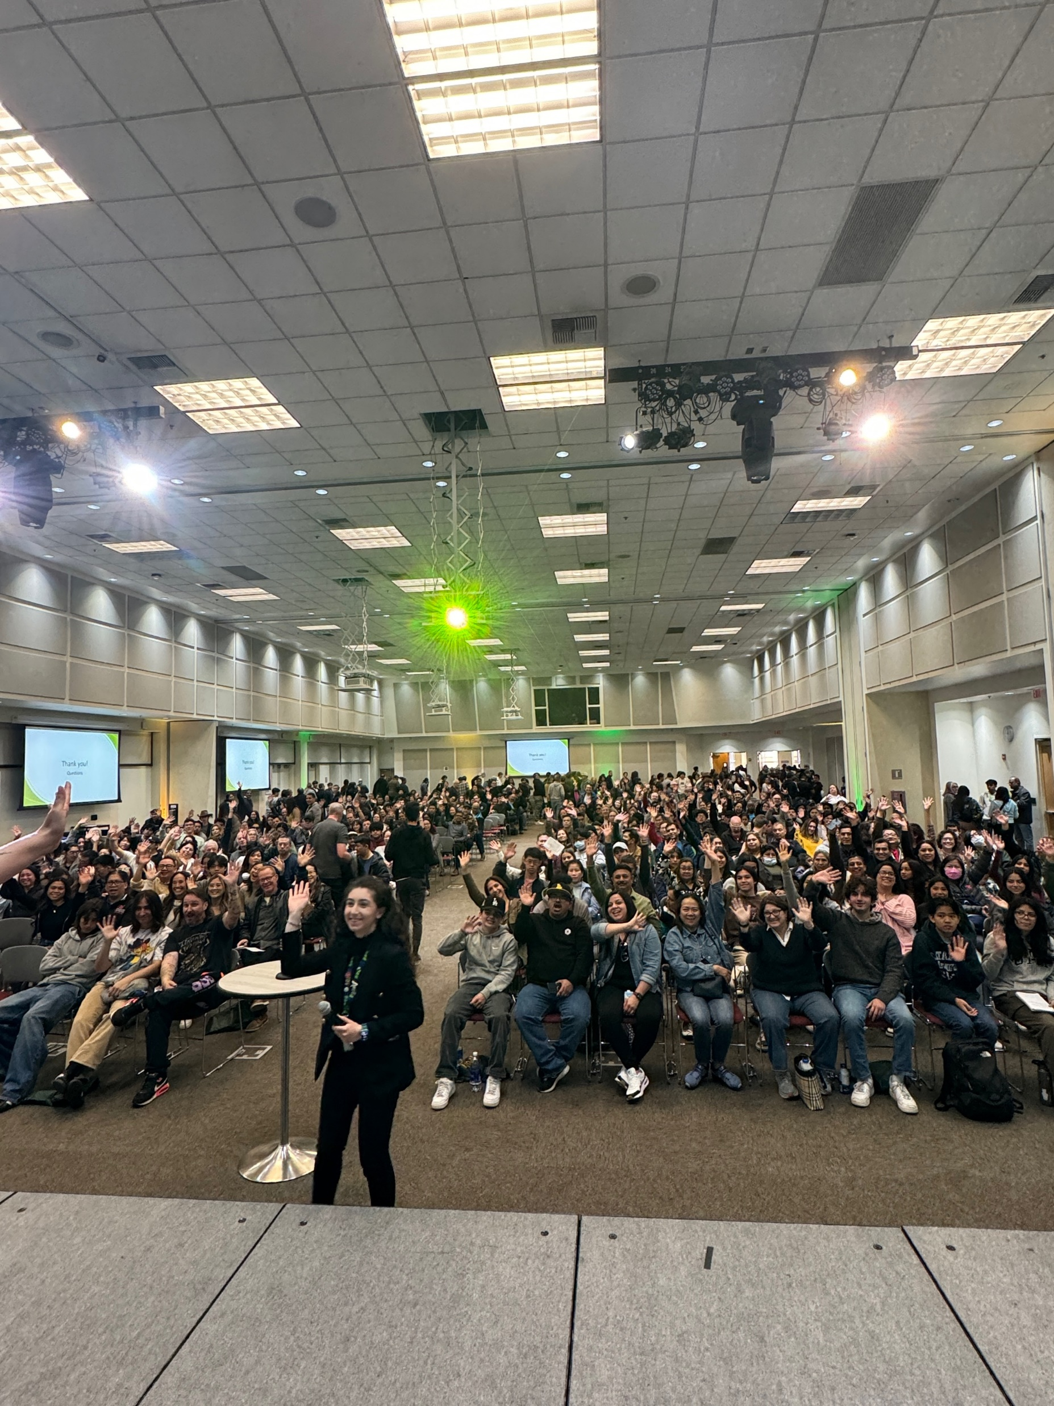
Open House 2024 Recap
2024 – Fall 1,600 prospective students and guest
2024 – Spring 3,520 and 10,506 with guests
1,293 more students than last year
3,763 more attendees than last year
328 students accepted their offer of admission
BSC presentation was at full capacity (600+)
2nd presentation was 80% full
Attendance up compared to last year
Survey feedback
Positive feedback – event contributed to decision to commit
Engaging resource fair

Slide 6
Event Details
Key Locations
Key Activities
Academic Colleges
University Park
University Quad
Library
Bookstore
Bronco Student Center
Campus Tour via Shuttles
Visit your College!
Swag Distribution
Student Club Fair
Library – Next Step Center
Resource Fair
Enterprise Showcase
Presentation/Information Sessions

Slide 7
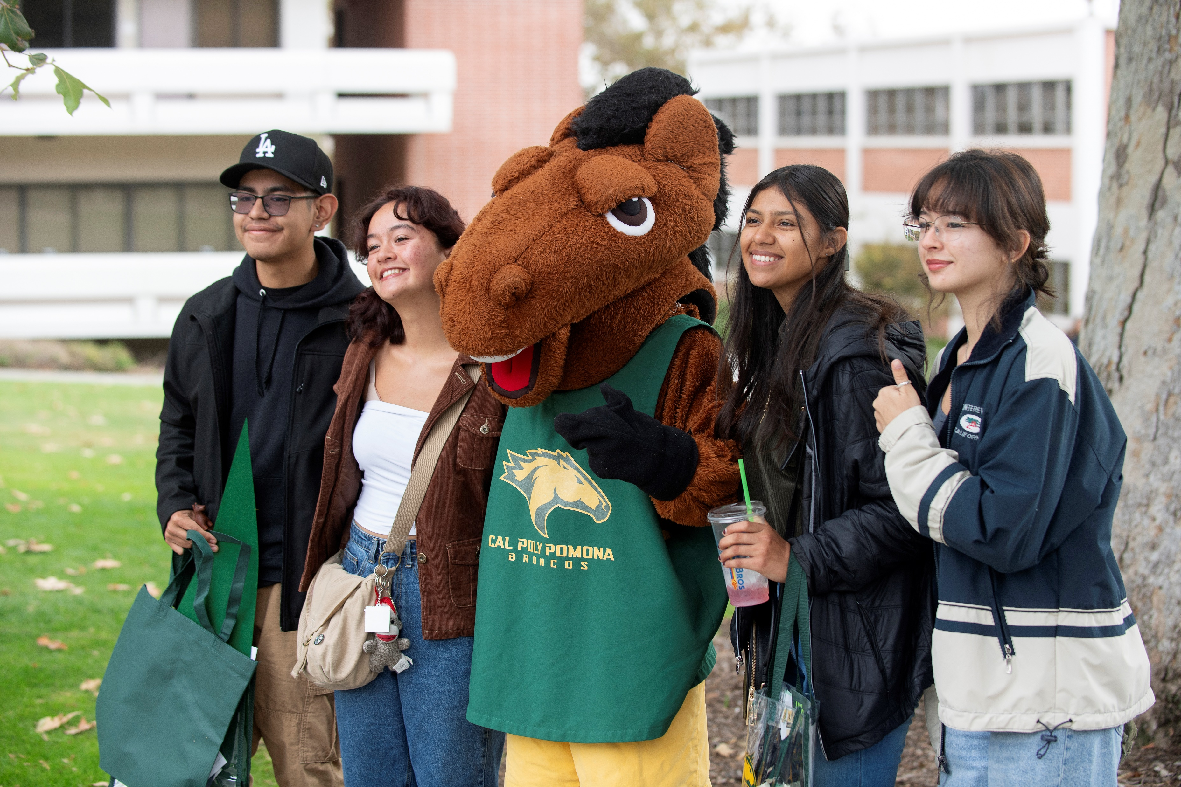
Key Partners
Cross Divisional
Academic Colleges
Campus Auxiliaries
Community Partners
Over 100 High Schools
Over 30 Community Colleges
Faith Based Organizations
Various Vendors

Slide 8
Reoccurring Early Access Request for BSC
Dates: First Saturday of November for Explore CPP
Second Saturday of April for BroncoBound
Benefits of Early Access:
Coordination with Sister Campuses
Efficient Event Planning
Enhanced Yield Efforts

Slide 9
Jack and Jill Annual Teen Conference

Slide 10
Jack and Jill of America Foundation
Oldest African-American-led nonprofit organization in the United States
Annual Teen Conference brings attendees together for:
Leadership Development
Networking
Community Building
Recognize Achievement

Slide 11
Why is this an important partnership?
Unique opportunity to introduce Cal Poly Pomona to 350+ Black Teens and Moms which will have significant long-term implications for Black student recruitment
Increased visibility for students from across the Far West Region of Jack & Jill, including AK, AZ, CA, NV, OR, WA
Opportunity to empower historically underrepresented students and educate them on the opportunities awaiting them at CPP
Strengthen CPP's presence within community
The Jack & Jill Foundation's mission of developing leadership, academic excellence, and cultural awareness aligns with CPP's mission to foster diversity, inclusion, and academic success.

Slide 12
Event Details
Moving-In to CPP Housing: June 25, 2025 (Staff); June 26 (Attendees)
Conference Dates: June 26-29, 2025
Facility/Meeting Needs
Various rooms within BSC to accommodate plenary sessions and workshops.
Conference schedule includes breakout sessions, large group sessions, and project spaces.
Campus Partners
University Housing
License of Facilities
Orientation Services
Sheraton Fairplex Hotel & Conference Center

Slide 13
Sample Day Schedule 2024 Teen Conference (University of Portland)
7am – 8:30am – Breakfast
9am – 11am – Plenary Session (Large Group)
11am – 12pm – Admissions Workshop
12pm – 1pm – Lunch
1pm – 4pm – Mother's Programming Workshops
4:15pm – 5:30pm – Competition
5:30pm – Load Buses
7pm – 12am – Social Gathering

Slide 14
One-Time Early Access Request for BSC
Dates: Wednesday, June 25 – Sunday, June 29
Benefits of Early Access:
Coordination with Sister Campuses
Efficient Event Planning
Enhanced Yield Efforts

Slide 15
Questions

