Slide 1
ASI Annual Budget Presentation
2015-2016

Slide 2
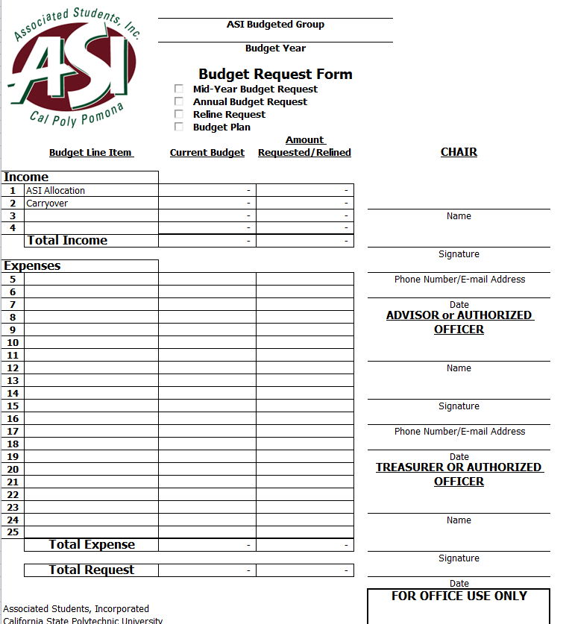
Budget Request Form (Incomplete)

Slide 3
Step 1
Income:
ASI Allocation: The money/funding received from your council.
Carryover: The money/funding left over from the previous year.
Income: The money you plan on fundraising or contributing
*Your income amount should equal to at least 20% of your total request

Slide 4
Step 2
Current Budget Income:
ASI Allocation: The amount your receive from your council in the previous year.
Carryover: The amount that was carried over last year.
Income: The amount your club raised through fundraisers or personal contributions last year.
*You can get all these numbers for the previous year from Financial Services.

Slide 5
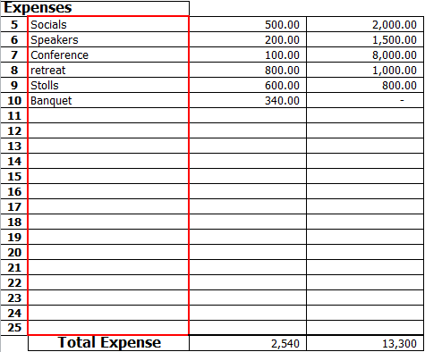
Step 3
Current Budget Expenses:
Line items 5-25 should reflect your previous budgeted events and future events as well.
For example, Socials was budgeted in last year’s budget and in this year’s budget. However, Banquet was budgeted for last year but not this year.

Slide 6
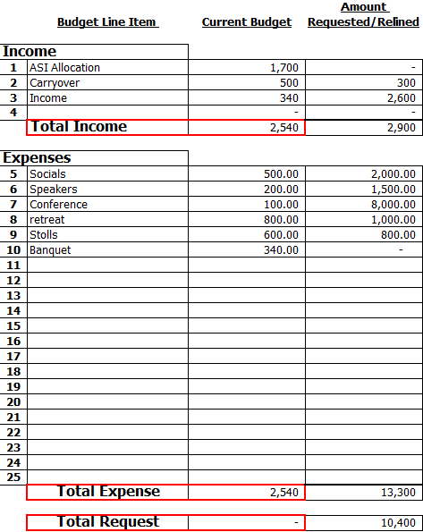
Step 4
Balancing the Current Budget:
Your Total Income should equal to your Total Expense making the Total Request equal to 0.
Since your Current Budget Total Income must equal to the Current Budget Total Expense, distribute your Total Income amongst your expense line items to reflect that you have spent all your income. This will result in a Total Request of 0.

Slide 7
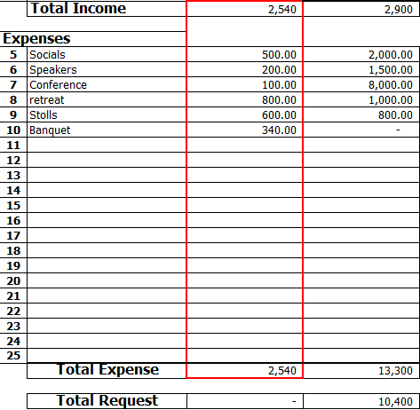
Continuing Step 4
How to Balance the Current Budget:
For example, our total income is $2,400. We estimated that last year’s E-Board used it in the following matter:
Socials $500 + Speakers $200 + Conference $100 + Retreat $800 + Stoles $600 + Banquet $200.
Resulting in the Total Expense of $2,400.
Since the Total Income equals Total Expense, the Total Request will equal to 0

Slide 8
Step 5
Amount Requested/Relined
Income:
ASI Allocation: This line should be blank because your club has not yet received an allocation for this year.
Carryover: This is the amount leftover funds from the previous year.
Income: This is the amount you plan to fundraise throughout the year.
*The amount in the income line reflects 20% of your total request. However, note that you only fundraise 20% of what is allocated to you.
For example, if you are allocated $1,700, you must raise $340 by March 1st.

Slide 9
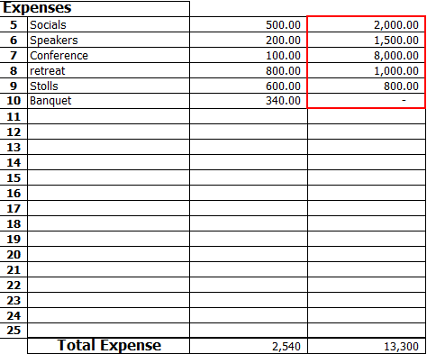
Step 6
Amount Requested/ Relined Expenses:
These numbers represent how much your club will approximately spend, on each line item, throughout the year.
*Note that how banquet will not be planned for this year.

Slide 10
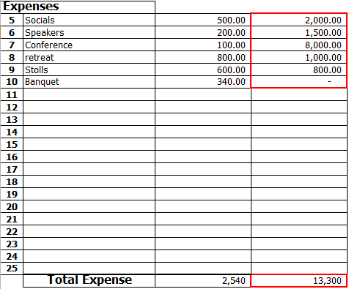
Step 7
Amount Requested/ Relined
Total Expense:
The Total Expense will equal all your line items.
For example, Socials $2,000 + Speakers $1,500 + Conference $8,000+ Retreat $1,000 + Stoles $800
Resulting in the Total Expense of $13,300.

Slide 11
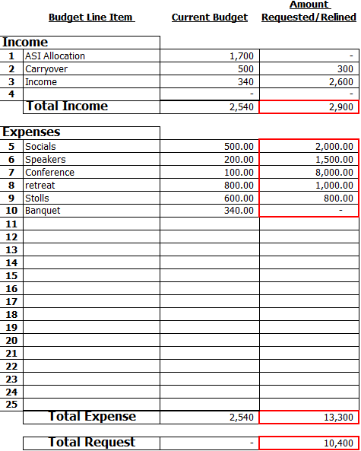
Step 8
Amount Requested/ Relined
Total Request:
Total Expense minus Total Income equals Total Request.
*This will be done automatically through excel formula. But double check to make sure.

Slide 12
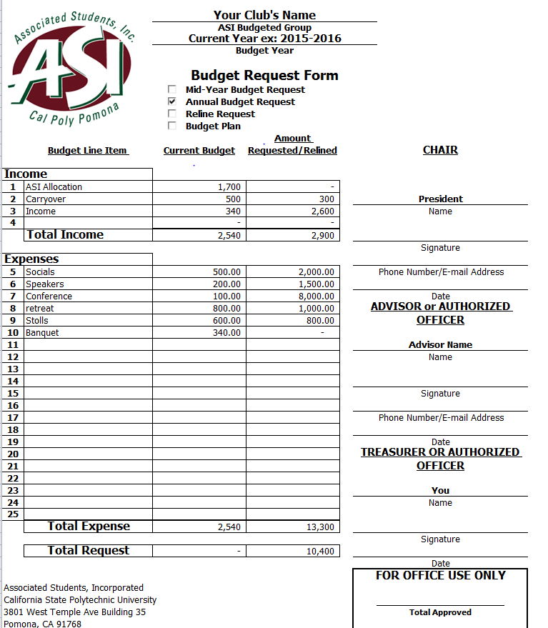
Budget request Form (Complete)

Slide 13
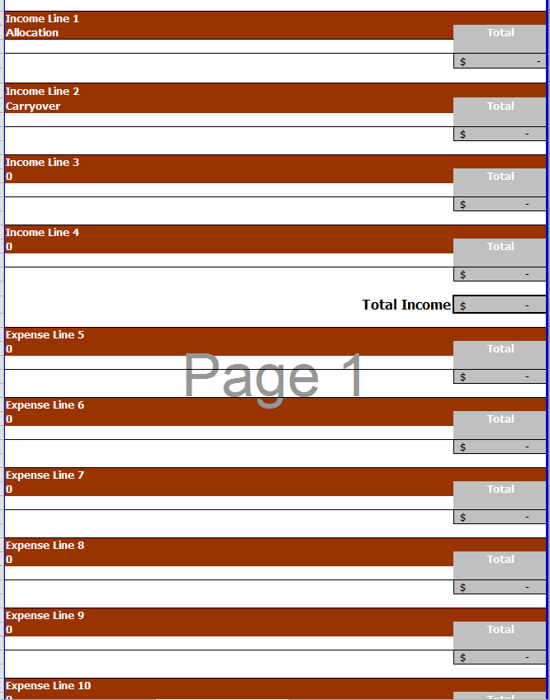
Line Item Explanation (Incomplete)

Slide 14
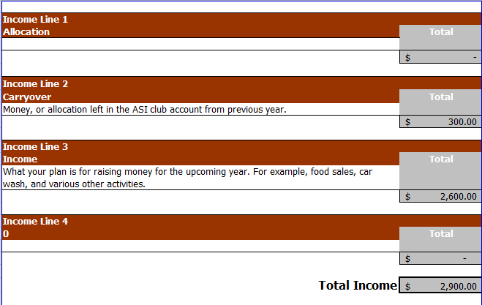
Line Item Explanation: Income

Slide 15
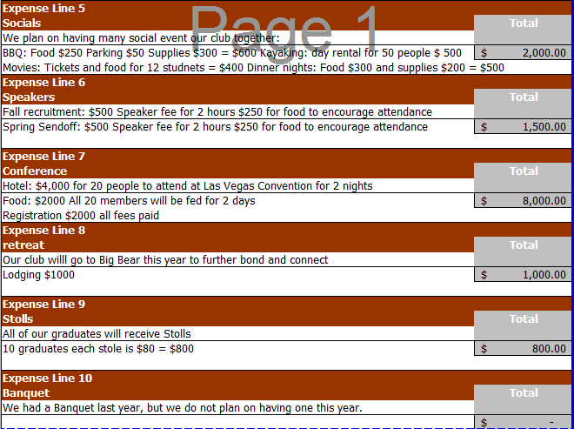
Line Item Explanation: Expense

Slide 16
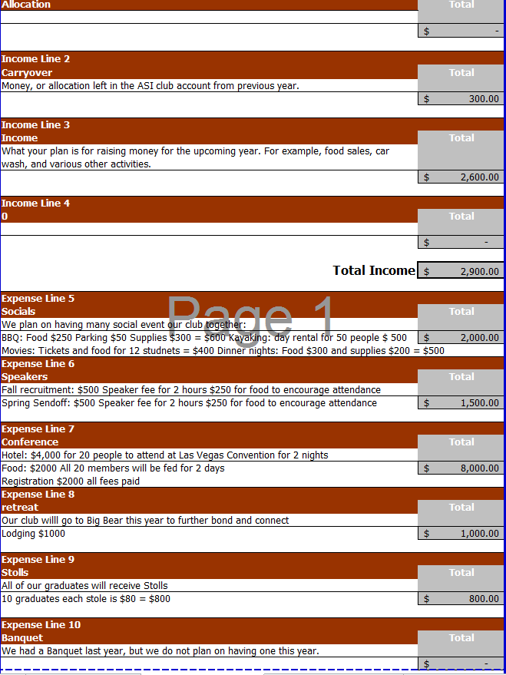
Line Item Explanation (Complete)

Slide 17
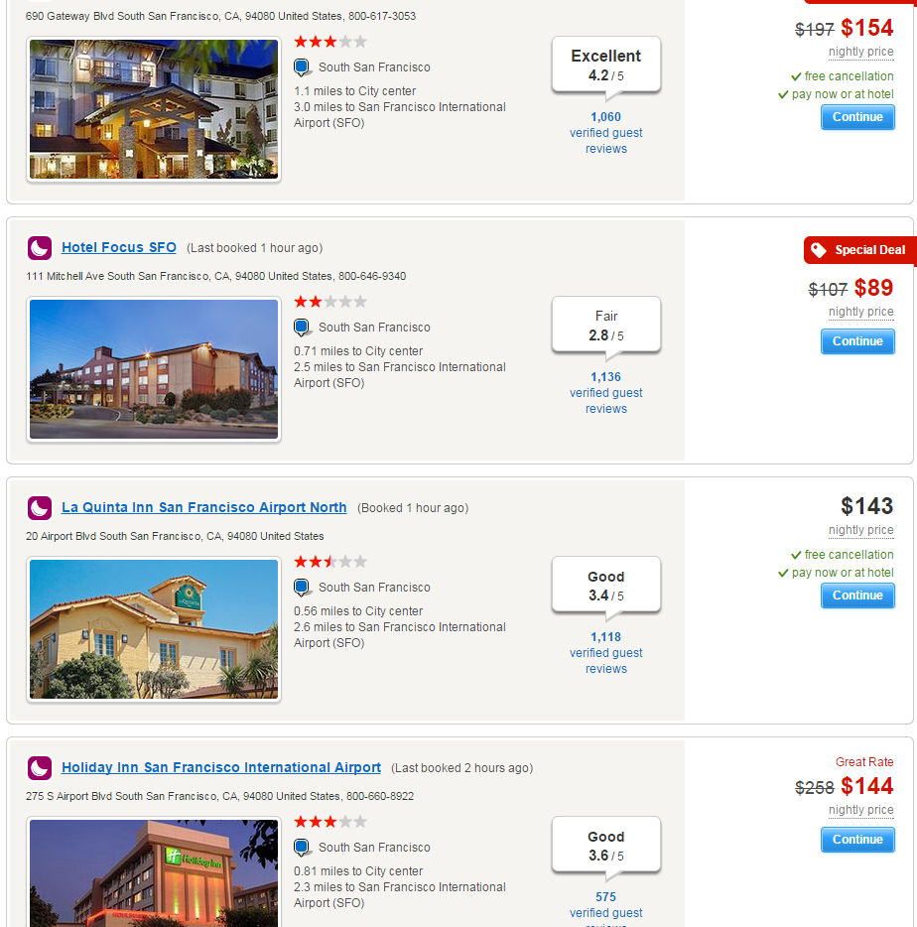
Quotes or Estimated Prices
Please attach quotes, flyers and price descriptions to all expense line items.

Slide 18
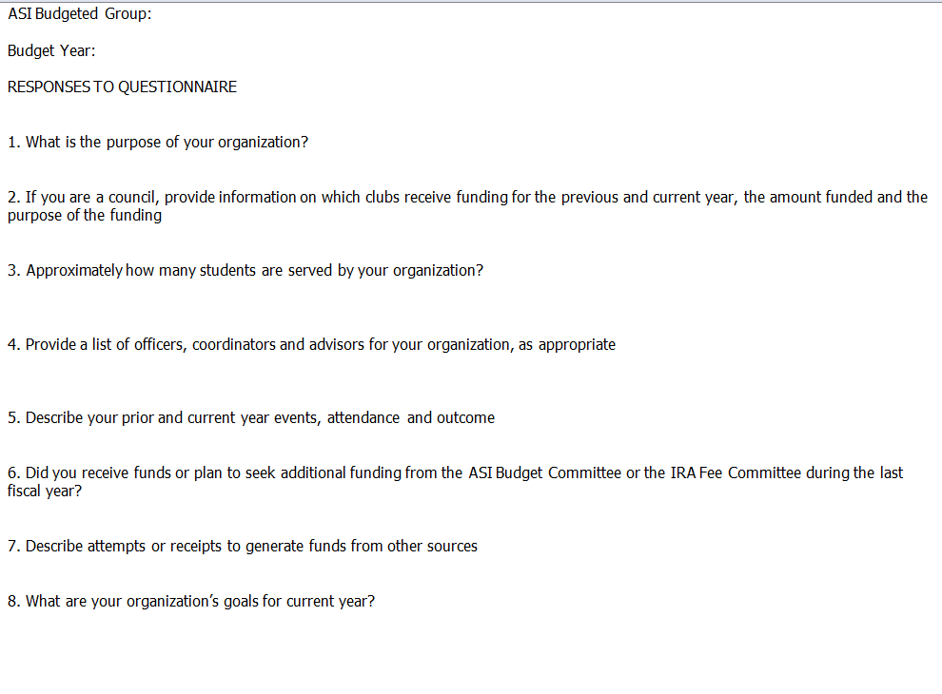
Response To Questionnaire

Slide 19
What Not To Include
Alcohol
Drugs/Tobacco Products
Weapons
Religion/Politics
Paying for Staff or Faculty
Hazing
Scholarships
All Other items listed in the Financial Guidelines and Stipulations

Slide 20
Process
Register through OSL/MyBar
Plan for all events of the year
Create the budget and get all appropriate signatures
Turn your budget to your Council
Your council will decide how much to allocate to you
Your Council Will turn in your budget to Financial Services
You may not turn in your budget directly to Financial Services
If there are any issues with your budget they will email you to the email you provided.

Slide 21
Questions?

